Slide 1
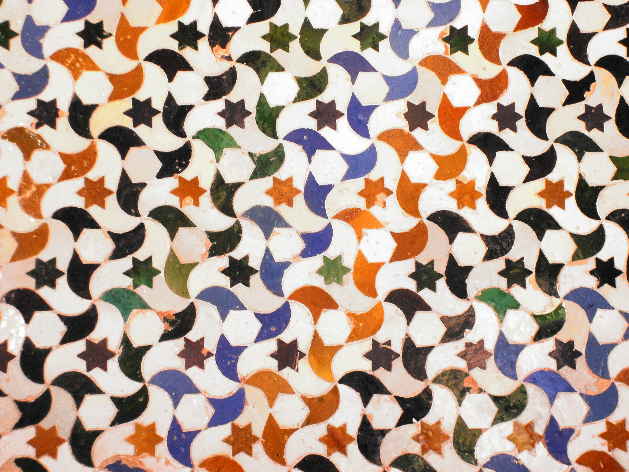
Wallpaper Groups

Slide 2
Def: Wallpaper Group
Def: Wallpaper Group
Group of isometries of the Euclidean plane that contains
two linearly independent translations

Slide 3
Isometries of the plane
Translations
Rotations
Reflections
Glide Reflections

Slide 4
Def: Wallpaper Group
Def: Wallpaper Group
Group of isometries of the Euclidean plane that contains
two linearly independent translations

Slide 5


Slide 9
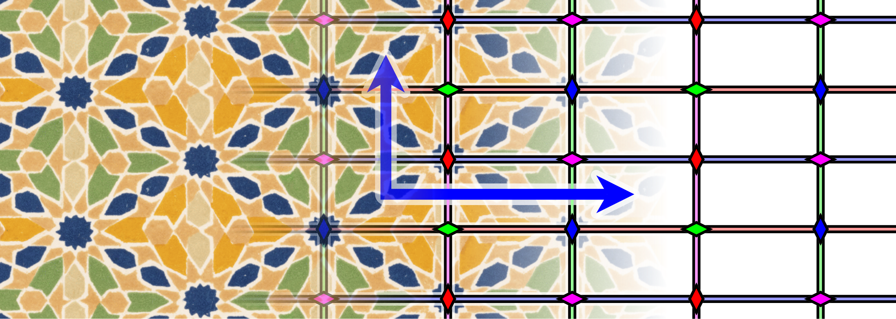
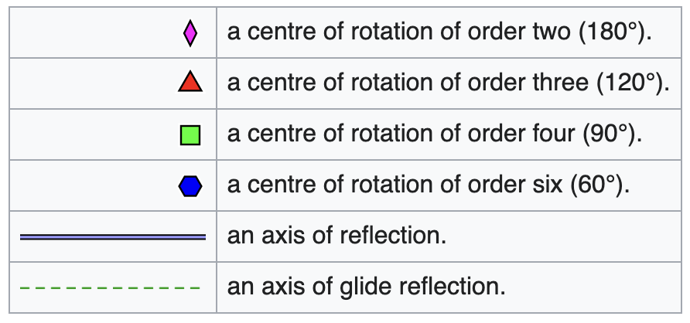
By Martin von Gagern - http://www.morenaments.de/gallery/exampleDiagrams/, CC BY-SA 3.0, https://commons.wikimedia.org/w/index.php?curid=7403022

Slide 10
There are only 17 wallpaper groups

Slide 11
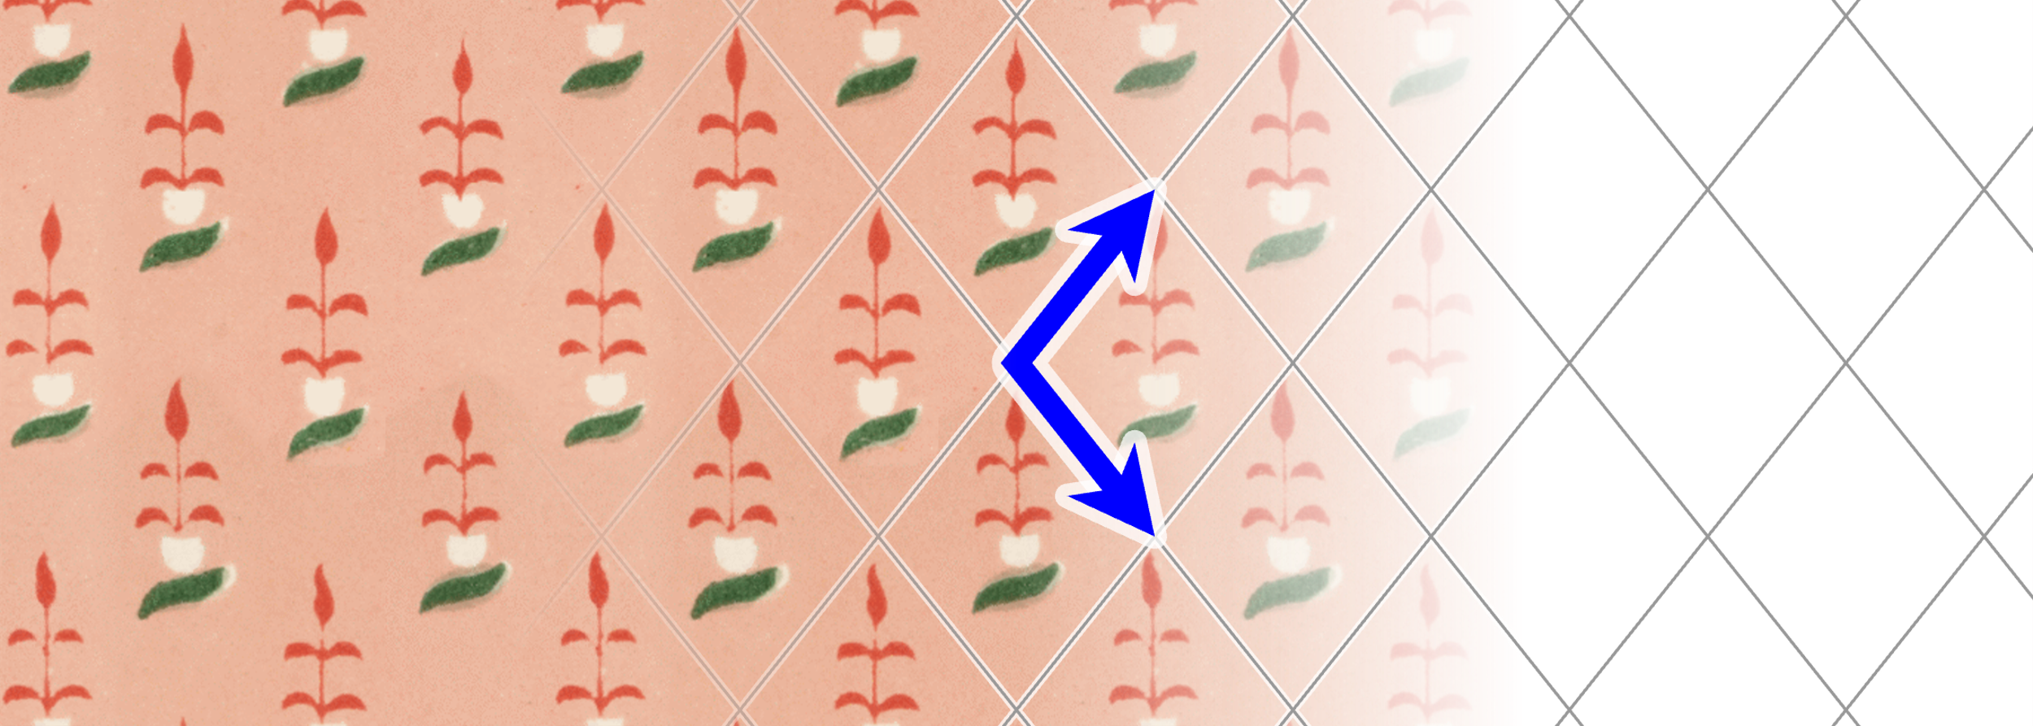
By Martin von Gagern - http://www.morenaments.de/gallery/exampleDiagrams/, CC BY-SA 3.0, https://commons.wikimedia.org/w/index.php?curid=7402990
o

Slide 12
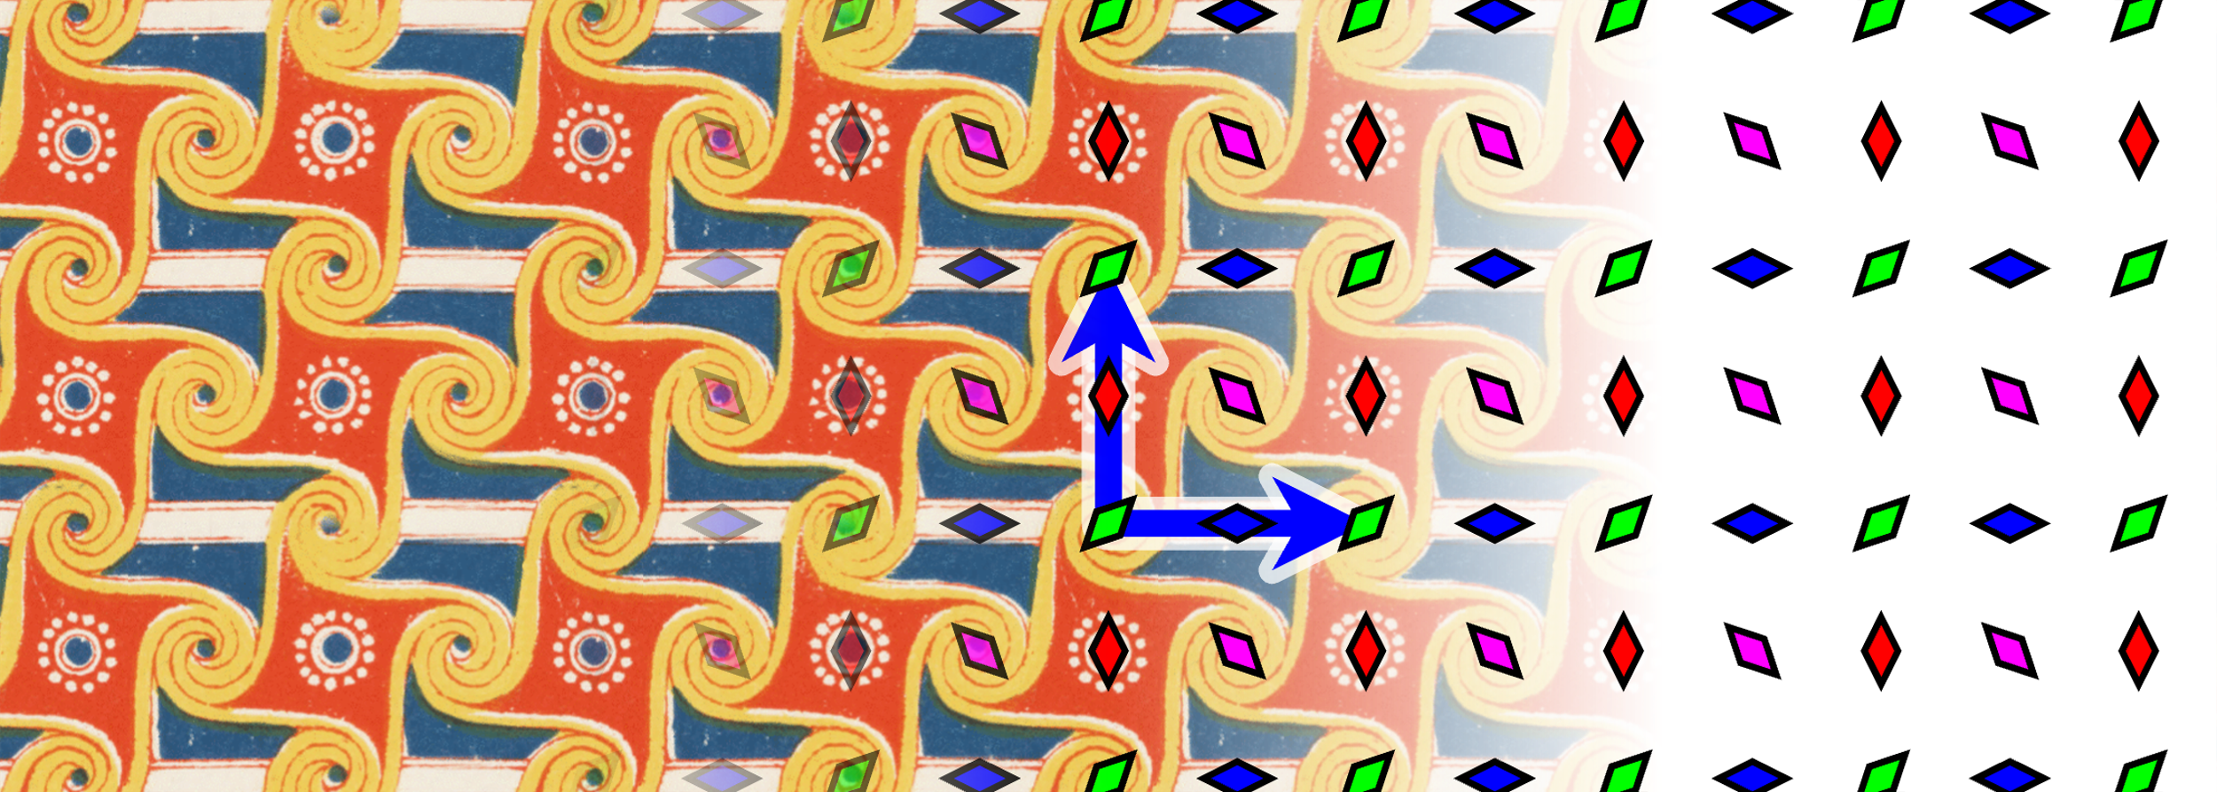
By Martin von Gagern - http://www.morenaments.de/gallery/exampleDiagrams/, CC BY-SA 3.0, https://commons.wikimedia.org/w/index.php?curid=7402993
2222

Slide 14
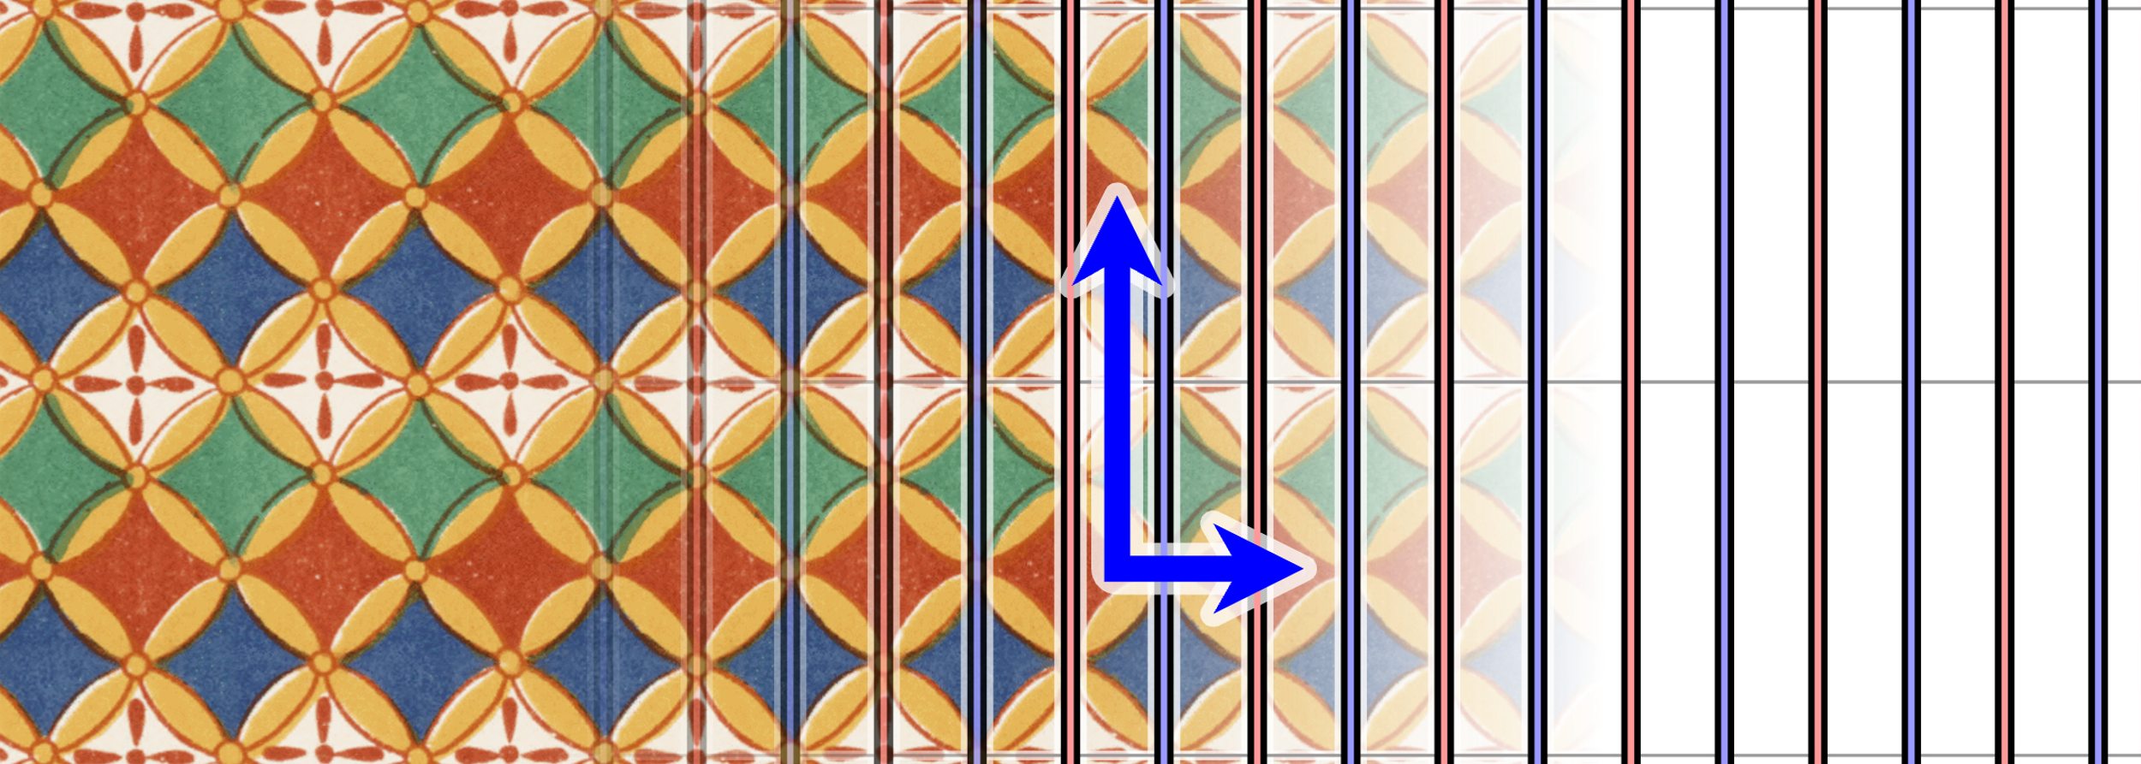
By Martin von Gagern - http://www.morenaments.de/gallery/exampleDiagrams/, CC BY-SA 3.0, https://commons.wikimedia.org/w/index.php?curid=7403020
**

Slide 15
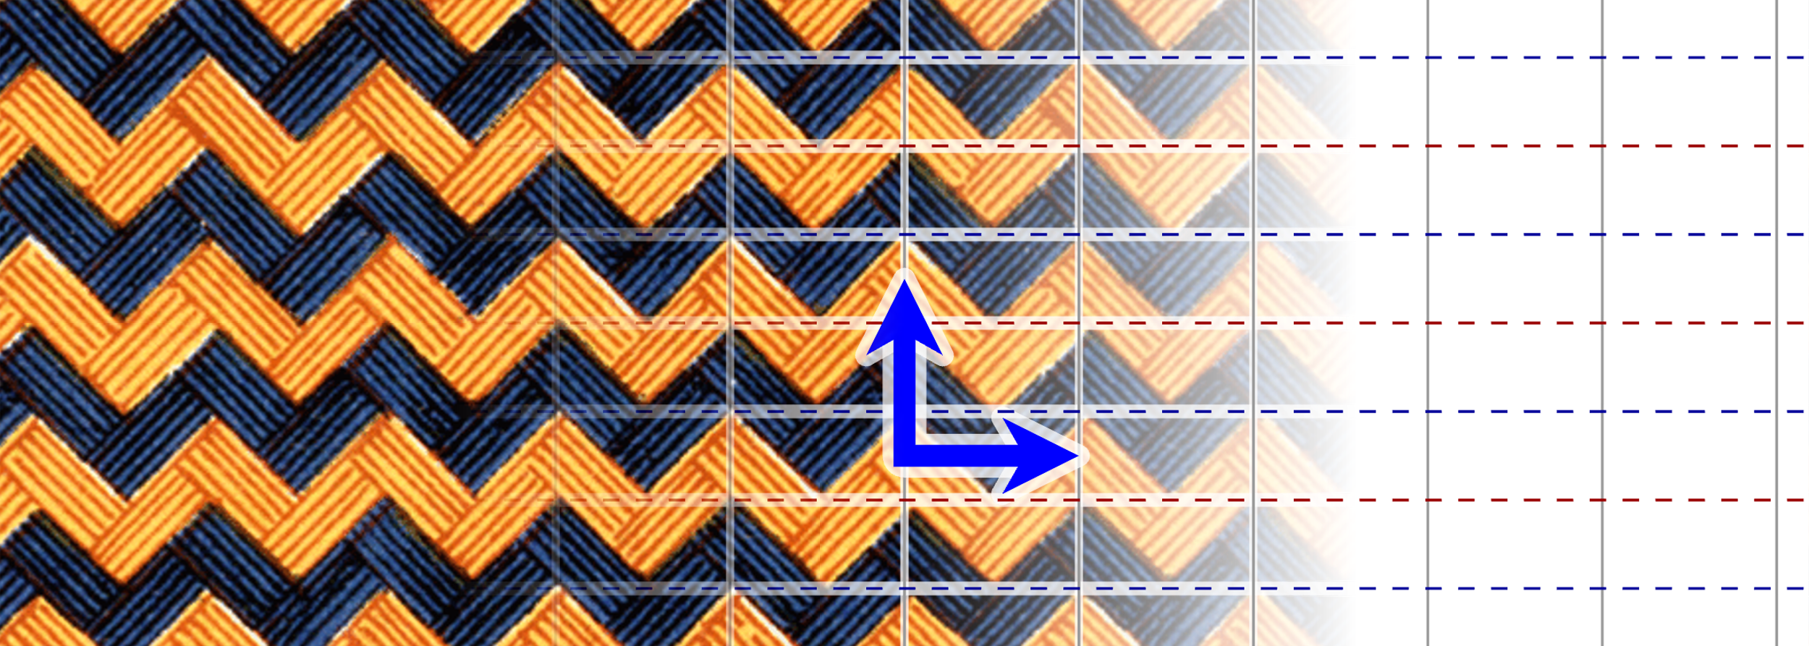
By Martin von Gagern - http://www.morenaments.de/gallery/exampleDiagrams/, CC BY-SA 3.0, https://commons.wikimedia.org/w/index.php?curid=7403014
××

Slide 16
By Martin von Gagern - http://www.morenaments.de/gallery/exampleDiagrams/, CC BY-SA 3.0, https://commons.wikimedia.org/w/index.php?curid=7403022
*2222

Slide 17
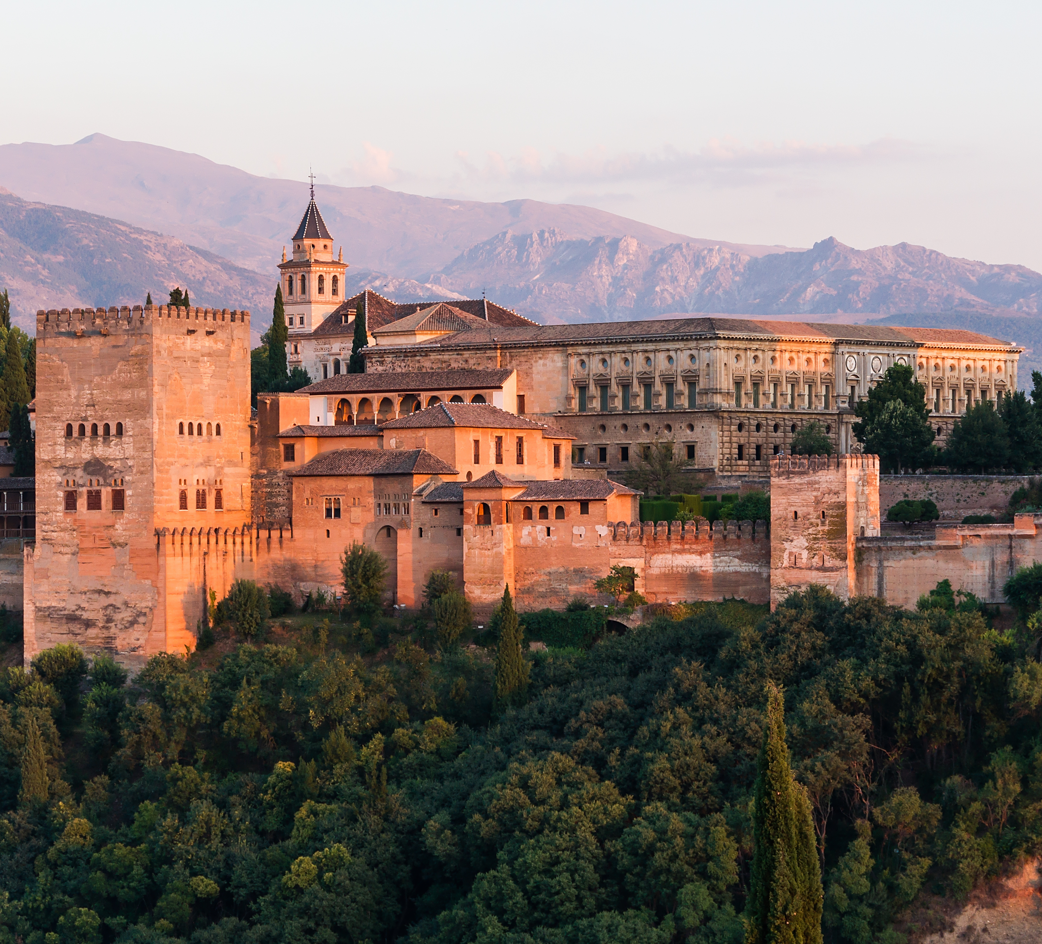
Alhambra (Granada, Spain)
14th-century palace/fortress in Granada, Spain
Known for its rich Islamic geometric tilework
“contains all 17 wallpaper groups”
Studied by artists like M.C. Escher

Slide 18
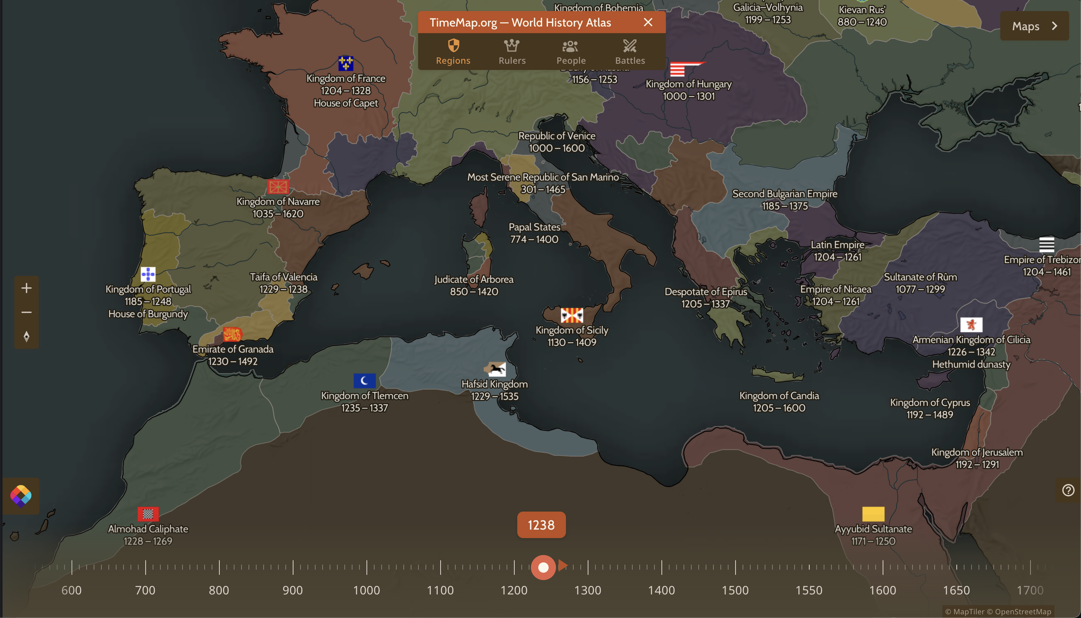

Slide 19
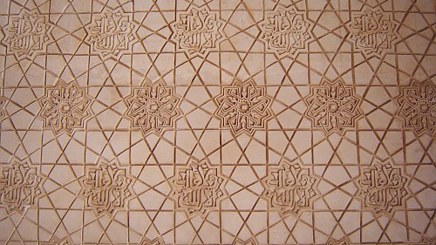

Slide 20
333

Slide 21
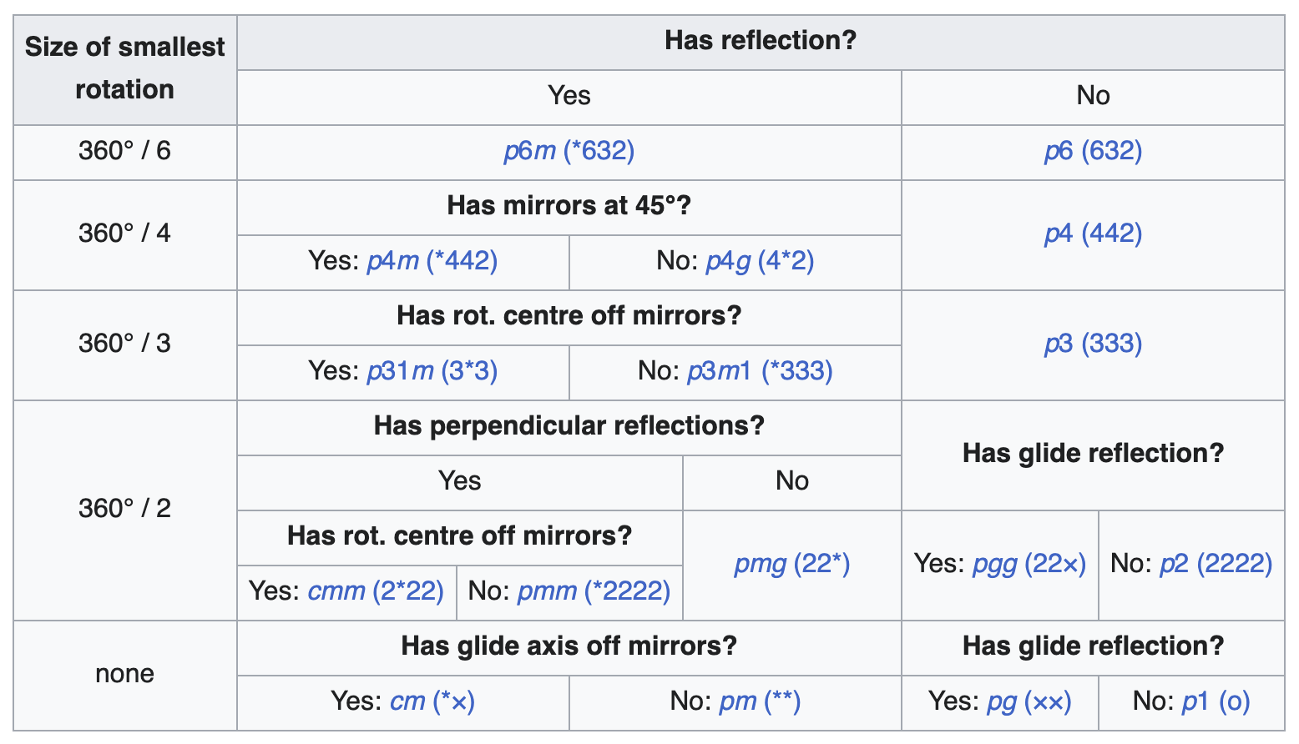

Slide 22
Def: Wallpaper Group
Def: Orbifold
Finite group quotient of a Euclidian space

Slide 23
By Martin von Gagern - http://www.morenaments.de/gallery/exampleDiagrams/, CC BY-SA 3.0, https://commons.wikimedia.org/w/index.php?curid=7402990
o

Slide 24
Orbifold Notation
n before *: rotation of order n around gyration point
* : reflection
n after * : transformation of order 2n which rotates kaleidoscopic point and reflects over a line
× : glide reflection
o : only two linearly independent translations.

Slide 25
“Cost” of each of the symbols
n before * = ⁠(n − 1)/n⁠
n after * = (⁠n − 1)/2n⁠
* or × = 1
o = 2

Slide 26
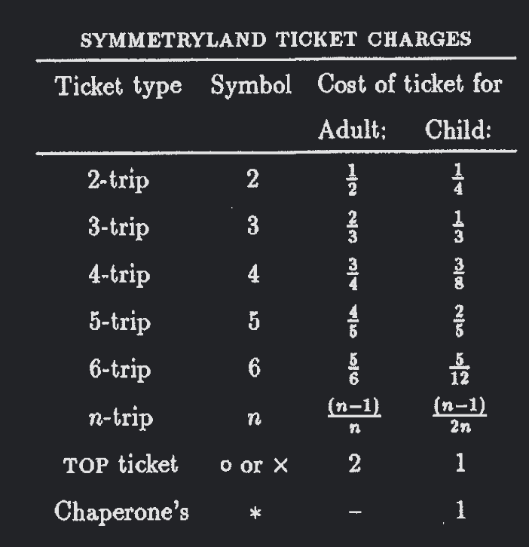

Slide 27
Conway's Magic Theorem
Orbifold Euler characteristic is 2 minus “cost of ticket”
Wallpaper groups have characteristic 0 ∴ the “cost” must be 2
There are only 17 ways to sum to 2 ∴ there are only 17 wallpaper groups

Slide 28
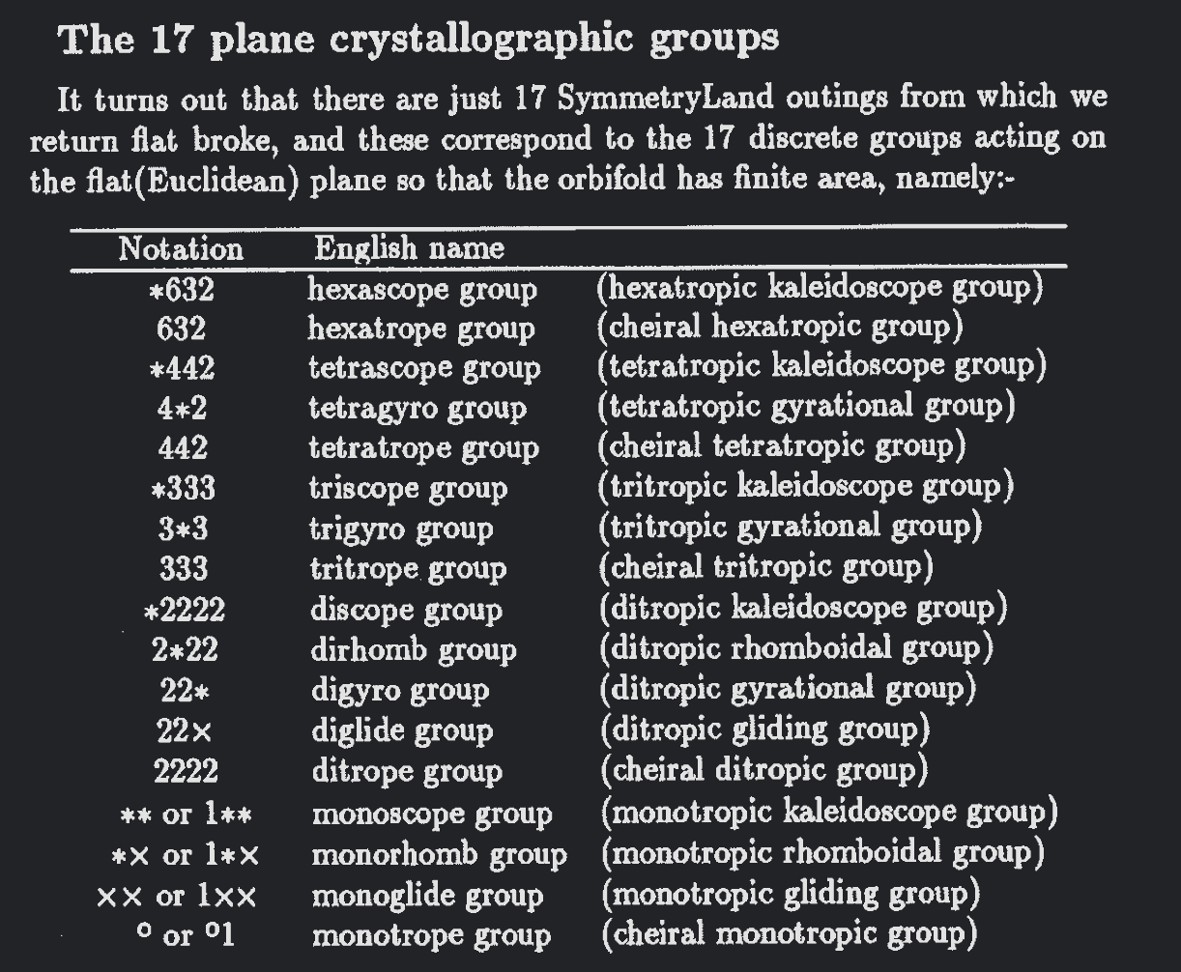

Slide 29
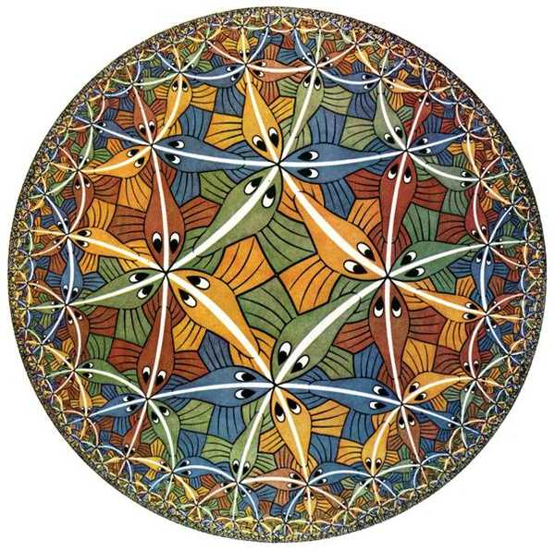
MC. Esher

Slide 30
References
The Orbifold Notation for Surface Groups (Conway)
Geometry and the Imagination in Minneapolis (Conway, Doyle, Gilman, Thurston)
John Baez: This Week's Finds in Mathematical Physics (Week 267)

